Slide 1
PROJECT
CATTLE MILK PRICE PREDICTION

Slide 2
AGENDA
OBJECTIVE
ABOUT DATA
TOOLS
STEPS FOLLOWED
ML ALGORITHMS AND ACCURACY
USE CASES

Slide 3
OBJECTIVE
PREDICT THE PRICE OF THE MILK FROM THE CATTLE USING REGRESSION TECHNIQUES (MACHINE LEARNING)

Slide 4
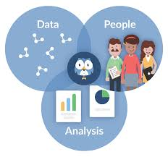
About data
3 TYPES OF BREED
1)CROSS BREED
2)COUNTRY BREED
3)BUFFALO
FEATURES CONSIDERED
BREED,AGE,MILK,SNF(IN MILK),FAT(IN MILK),FEED/KG,TEMP
FROM COW FARM

Slide 5
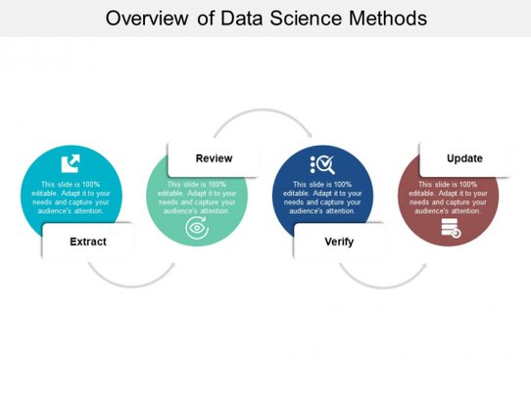
STEPS FOLLOWED
PREPROCESSING DATA
STATISTICAL REPORT
VISUALIZATION
DUMMY VARIABLES
TRAIN TEST SPLIT
FIT MODEL
MODEL EVALUATION

Slide 6
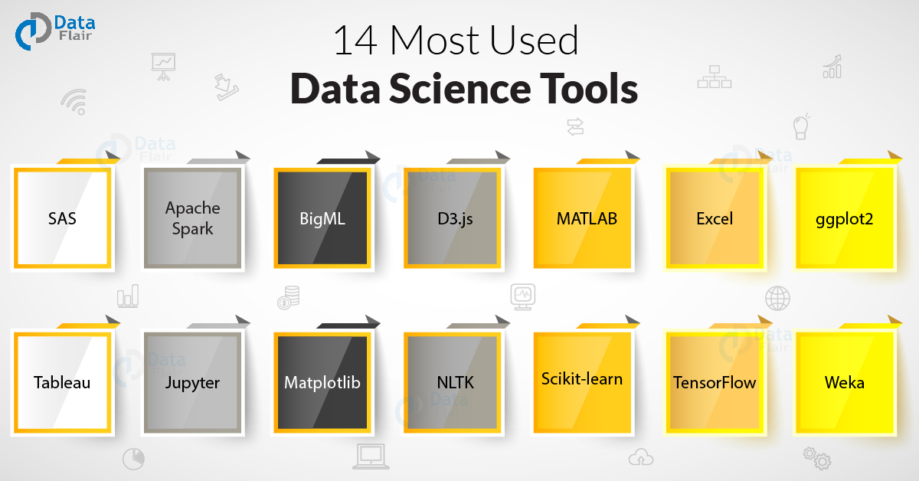
TOOLS
NUMPY
PANDAS
SEABORN
MATPLOTLIB
SCIKIT LEARN

Slide 7
ML algorithms used AND ITS ACCURACY
LINEAR REGRESSION =96%
DECISION TREE REGRESSION=99%
RANDOM FOREST(ENSEMBLE TECHNIQUES)=98%

Slide 8
USE CASES
ADDITIONAL FEATURES LIKE JAW MOVEMENT(USING SENSOR),COW MOVEMENT
IS USED TO PREDICT CATTLE HEALTH
USED IN FARMS TO PREDICT MILK PRICE AND CATTLE HEALTH

Slide 9
THANK YOU

